Slide 1
Course Code:CSC402A Course Title: Web Architecture and Application Development
Course Leader:
Kishore S.M.
kishore.cs.et@msruas.ac.in

Slide 2
Objectives
After completing this lecture, the student will be able to
Describe features of Java Enterprise Edition
Identify the components and services of Java Enterprise Edition

Slide 3
Contents
Java platforms
JEE architectural model
Servlets
JSP
Enterprise java beans
JEE services

Slide 4

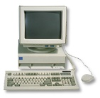
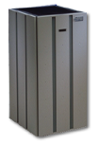


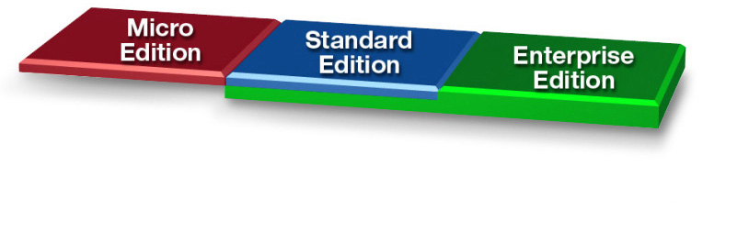
Java Platforms
Java Technology Enabled Desktop
Workgroup
Server
High-End
Server

Slide 5
Java Standard Edition (JSE)
A specification for the Java programming language and virtual machine, a suite of development tools (JDK), and a run-time environment (JRE)
Mainly for building desktop applications and applets
Write-Once Run-Anywhere
Used by JEE

Slide 6
Java Enterprise Edition (JEE)
The Java EE platform is built on top of the Java SE platform
Provides an API and runtime environment for developing and running large-scale, multi-tiered, scalable, reliable, and secure network applications
Tailored for more complex applications to suit medium to large businesses
Typically they will be server based applications focusing on serving the needs of lots of users at one time

Slide 7
Java Micro Edition (JME)
Java applications for ‘micro’ devices
Defines a Java development and run-time environment for embedded and consumer systems with restricted processing resources and with memory
The API is a subset of the Java SE API, along with special class libraries useful for small device application development
Java ME applications are often clients of Java EE platform services
JME is for
Applications used on mobile (E.g., cell phone, PDA)
Embedded devices (E.g., TV tuner box, printers)

Slide 8
What is JEE?
Open and standard based platform for
Developing, deploying and managing
n-tier, web-enabled, server-centric, and component-based enterprise applications
Simplify development of multi-tier applications
Handle difficult middleware requirements
Transactions
Security
Distributed objects
Scaling

Slide 9
N-tier JEE Architectural Model

Slide 10
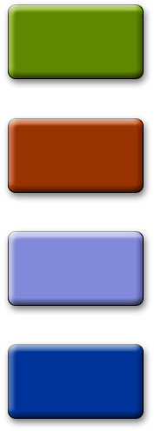
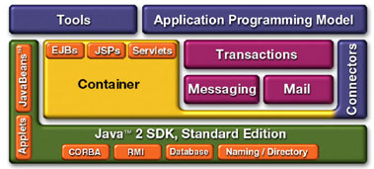
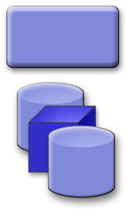
JEE Platform Architecture
B2B
Applications
Existing
Applications
B2C
Applications
Web Services
Application Server
Enterprise Information Systems
Wireless
Applications

Slide 11
JEE Architectural Model
A JEE application can logically be divided into
Presentation layer (client-side and server-side)
Business logic layer
Enterprise Information System (EIS) layer
The JEE specification defines various levels of support for components including client applications, web components (servlets and JSPs) and business logic components (EJBs)
The Java Connector Architecture (JCA) specifies how our JEE components may connect to the EIS layer

Slide 12
Web Server
Web server refers to an execution infrastructure that handles HTTP requests and responses
A web browser lets a user request a resource
The web server gets the request, finds the resource, and returns something to the user
The resource can be an HTML page, a picture, a sound file or even a PDF document
Web server can refer to either the hardware (the computer) or the software (the computer application) that helps to deliver content that can be accessed through the Internet

Slide 13
Web Server contd.
The web servers can also be used for data storage or for running enterprise applications
Web servers are able to map the path component of a Uniform Resource Locator (URL) into
A local file system resource (for static requests)
An internal or external program name (for dynamic requests)
E.g.,
Apache Tomcat
Oracle HTTP Server
IBM HTTP Server

Slide 14
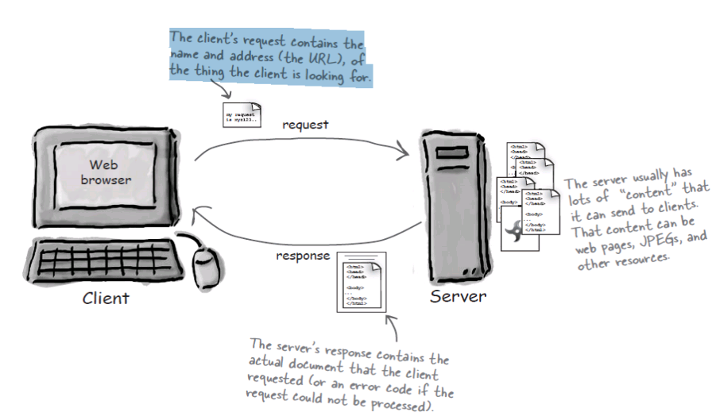
Web Server

Slide 15
Application Server
Server that is designed for or dedicated to running specific applications
Mediates between a Web server and backend systems, such as databases or existing applications
A component-based product that resides in the middle-tier of a server centric architecture
Provides “services” (sometimes called "components") to the application
Eliminate the need for the application developer to create or attempt to integrate and manage these (often complex) services from scratch

Slide 16
Application Server contd.
Services are invoked (implicitly or explicitly) by the application as needed, rather than being coded into the application
Supports multiple applications simultaneously
Requests from a client’s Web browser are passed from the Web server to the application server
The application server executes code that gathers the necessary information from other subsystems and composes an HTML reply, which is returned to the client’s browser

Slide 17
Application Server - Examples
An application server can be simple
Microsoft ASP (Active Server Pages), which comes with IIS (Internet Information Server)
They can be complex and expensive systems that implement load balancing, data management, caching, transaction management and security
Appache Tomcat
Microsoft .NET Server
BEA WebLogic
IBM WebSphere
Sun Java System Application Server etc

Slide 18
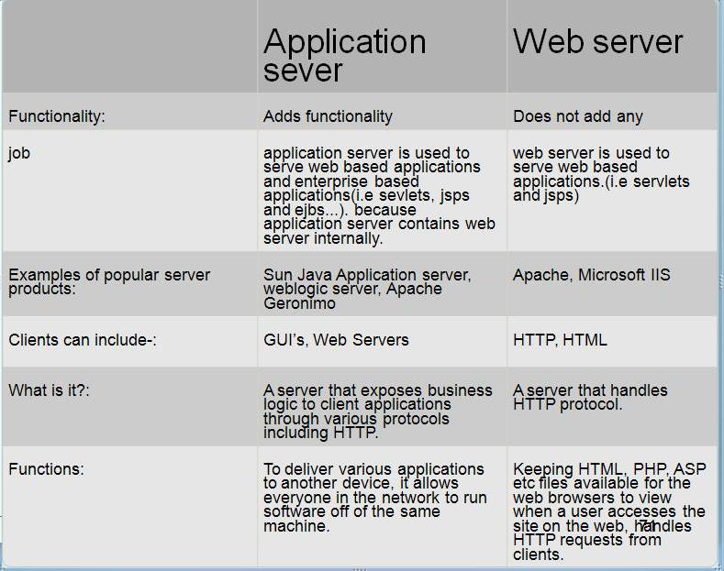
Application Server and Web Server

Slide 19
HTML
When a server answers a request, the server usually sends some type of content to the browser so that the browser can display it
HTML tells the browser how to display the content to the user
HTML stands for the Hyper Text Markup Language
HTML is not a programming language, it is a markup language
A markup language is a set of markup tags
HTML uses markup tags to describe web pages
<html>
<body>
<h1>My First Heading</h1>
<p>My first paragraph.</p>
</body>
</html>

Slide 20
HTTP
HTTP is the protocol clients and servers use on the web to communicate
Most of the conversations held on the web between clients and servers are held using the HTTP protocol, which allows for simple request and response conversations
The client sends an HTTP request, and the server answers with an HTTP response

Slide 21
HTTP Methods
GET is a simple request
GET is used to ask the server to get a resource and send it back
Resource might be an HTML page, a JPEG, a PDF, etc.
POST can send user data
With POST, you can request something and at the same time send form data to the server

Slide 22
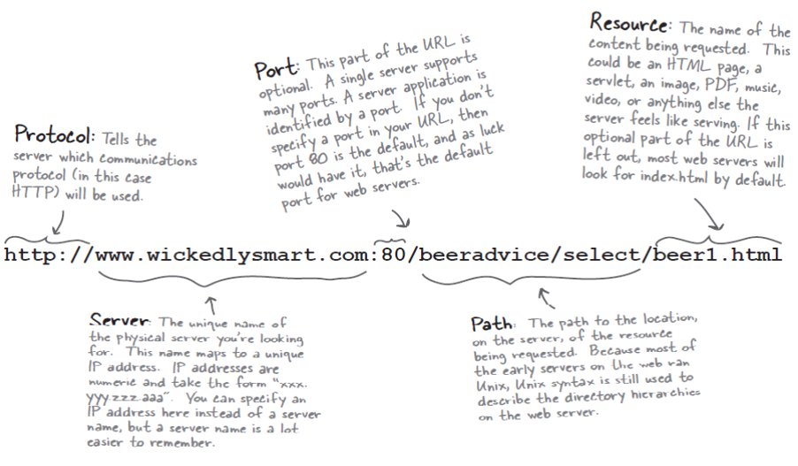
URL

Slide 23
Java EE Server
A Java EE server is a server application that implements the Java EE platform APIs and provides standard Java EE services
Sometimes called application servers
They allow you to serve application data to clients, much as web servers serve web pages to web browsers
Java EE servers host several application component types that correspond to the tiers in a multi-tiered application
The Java EE server provides services to these components in the form of a container

Slide 24
Containers
In software development terminology, the word container is used to describe any component that can contain other components inside itself
A hosting environment for software components
Examples of containers
Java applets, frames, windows, etc.
It provides execution support to the components it hosts in a way that is similar to an operating system hosting processes

Slide 25
Java EE Container
Java EE containers are the interface between the component and the lower-level functionality provided by the platform to support that component
The functionality of the container is defined by the platform and is different for each component type
The server allows the different component types to work together to provide functionality in an enterprise application

Slide 26
Types in JavaEE
JEE server
The runtime portion of a J2EE product
Provides EJB and Web containers
Enterprise JavaBeans (EJB) container
Manages the execution of enterprise beans for JEE applications
Enterprise beans and their container run on the JEE server
Web container
Manages the execution of JSP page and servlet components for JEE applications
Application client container
Manages the execution of application client components
Application clients and their container run on the client
Applet container
Manages the execution of applets

Slide 27
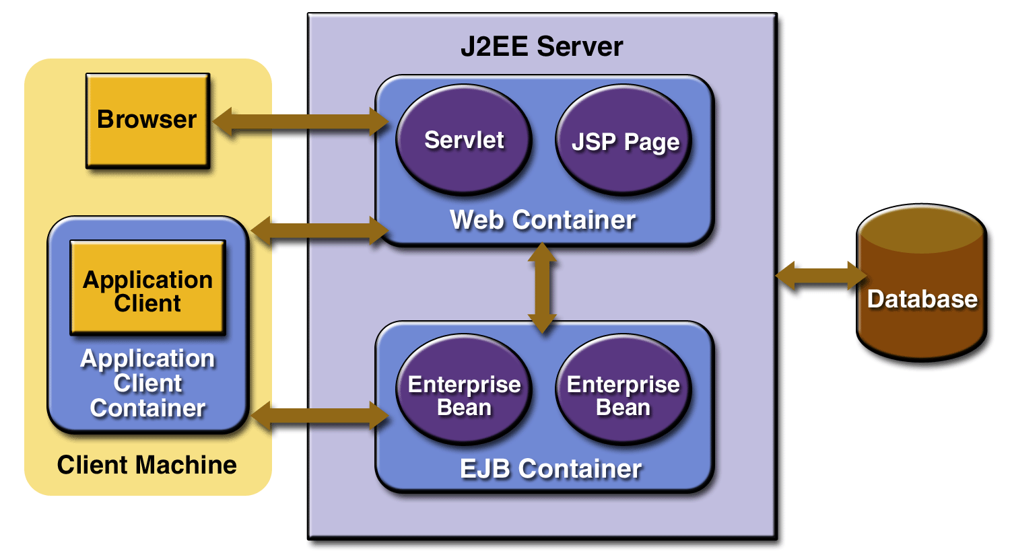
Container Types in JavaEE

Slide 28
Web Container
Interface between web components (such as servlets) and the web server
A web container implements the web component contract of the Java EE architecture, specifying a runtime environment for web components
The container manages
The component's lifecycle
Dispatches requests to application components
Provides interfaces to context data, such as information about the current request

Slide 29
Web Container - Examples
Non-commercial Web containers
Apache Tomcat (formerly Jakarta Tomcat) is an open source web container available under the Apache Software License
GlassFish (open source), from Sun Microsystems
JBoss Application Server (open source) is a full Java EE implementation by Red Hat inc., division JBoss.
Commercial Web containers
Sun GlassFish Server, from Sun Microsystems
Sun Java System Web Server, from Sun Microsystems
JBoss Enterprise Application Platform (open source)
JRun, from Adobe Systems (formerly developed by Allaire Corporation)
WebLogic Application Server, from Oracle Corporation (developed by BEA Systems)
WebSphere Application Server, from IBM

Slide 30
EJB Container
Interface between enterprise beans, which provide the business logic in a Java EE application, and the Java EE server
The EJB container runs on the Java EE server and manages the execution of an application's enterprise beans

Slide 31
Summary
Different Java platforms are
Java Standard Edition
Java Micro Edition
Java Enterprise Edition
A JEE application server consists of
A Web container
An EJB container
Servlets are Java objects which extend the functionality of a HTTP server
JSP pages are HTML pages with embedded Java
EJB is a server-side component technology

